Slide 1
Lab 4
Database and JSP & Servlet

Slide 2
MySQL
Lab resource
  Lab 4 - Database_MySQL_JSP.pdf
  Lab 4.ppt
Other resource: Navicat or MySQL Workbench
Software resource: MySQL
  Is a popular database of many system.
  Can do anything as a DBMS does

Slide 3
Step to build DB page with Java
Build database and tables
Build JSP or Servlet pages
Write source code to connect from JSP to database
Write source code to manipulate data (insert, delete, update, retrieve) in that pages

Slide 4
Build database and tables
Start mySQL by run some tools such as MyAdmin… or mysqld.exe in console window.
Connect to database (use some accounts) by Navicat Lite. Default server running at localhost:3306
Create a database schema
Create tables to contain data
Insert data into table

Slide 5
Build JSP or Servlet pages
Create a JSP or servlet class as normal

Slide 6
Connect to database server
Using JDBC (Java DataBase Connectivity)
  Make reference to package jar file
    MySQL JDBC Driver at “C:\Program Files\NetBeans 7.0\ide11\modules\ext\ mysql-connector-java-8.0.18.jar”
    Or add library “MySQL JDBC Driver” to your project. This library is built-in of Netbean, but it is older version
Follow by steps:
  Import packages
    Put following code to your program
      import java.sql.*;
  Put mysql package reference to your project
  Load the driver (JDBC)
    Code: Class.forName(“com.mysql.jdbc.Driver“);

Slide 7
Connect to database server (cont.)
  Define the connection URI
    String URI = "jdbc:mysql://localhost:3306/weblab5“;
  Establish the connection
    Connection conn = DriverManager.getConnection(URI,"root","");

Slide 8
Steps to manipulate data
Create a statement object from connection object
  Statement stmt = conn.createStatement();
Execute a query
    String sql = “select * from … “;
    ResultSet rs = stmt.executeQuery(sql);
    Or stmt.execute(“insert into…“);

Slide 9
Steps to manipulate data (cont.)
Process a results (display for edit, new…)
  while (rs.next()) {
    String ID = rs.getString (1);
    //or String ID = rs.getString(“ID”);
    long YOB = rs.getLong(2);
    //or long YOB = rs.getLong(“YOB”);
    }
Close the objects (should be closed when application is exited)
  rs.close();
  stmt.close()
  conn.close()

Slide 10
Hint: How to edit and delete a row in table
Create a hyperlink.
For example if you have an action file “action.jsp” and you want edit on studentID, you can do as follow:
  When you display row, you can add an additional link such as
  <a href= “action.jsp?studentID=09023283”> Edit </a>

Slide 11
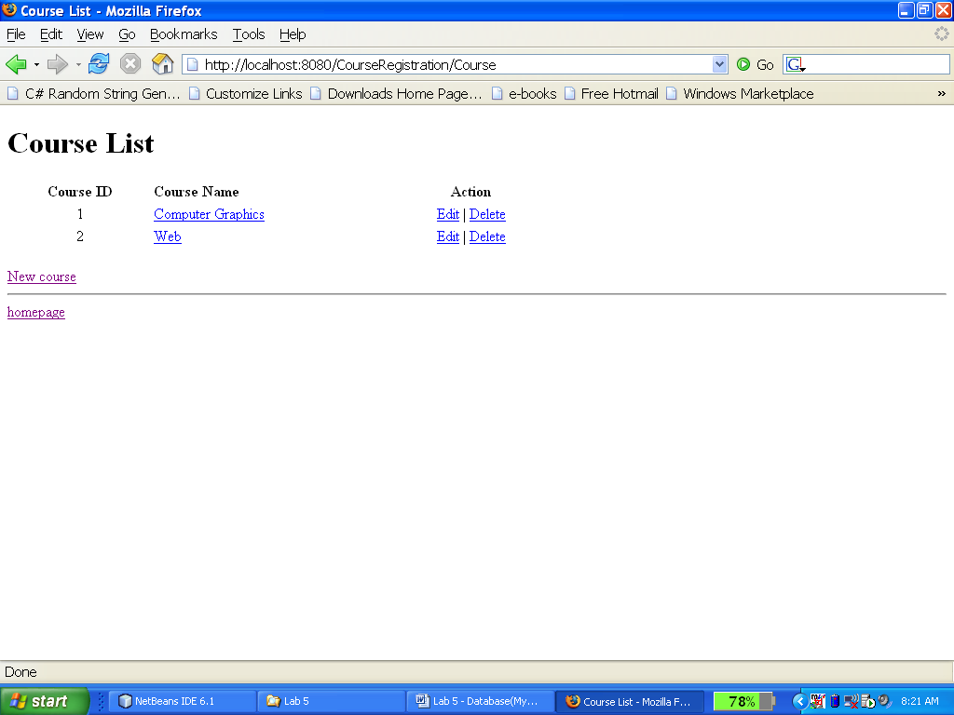
Example: editing and deleting row

Slide 12
Question?

